Slide 1
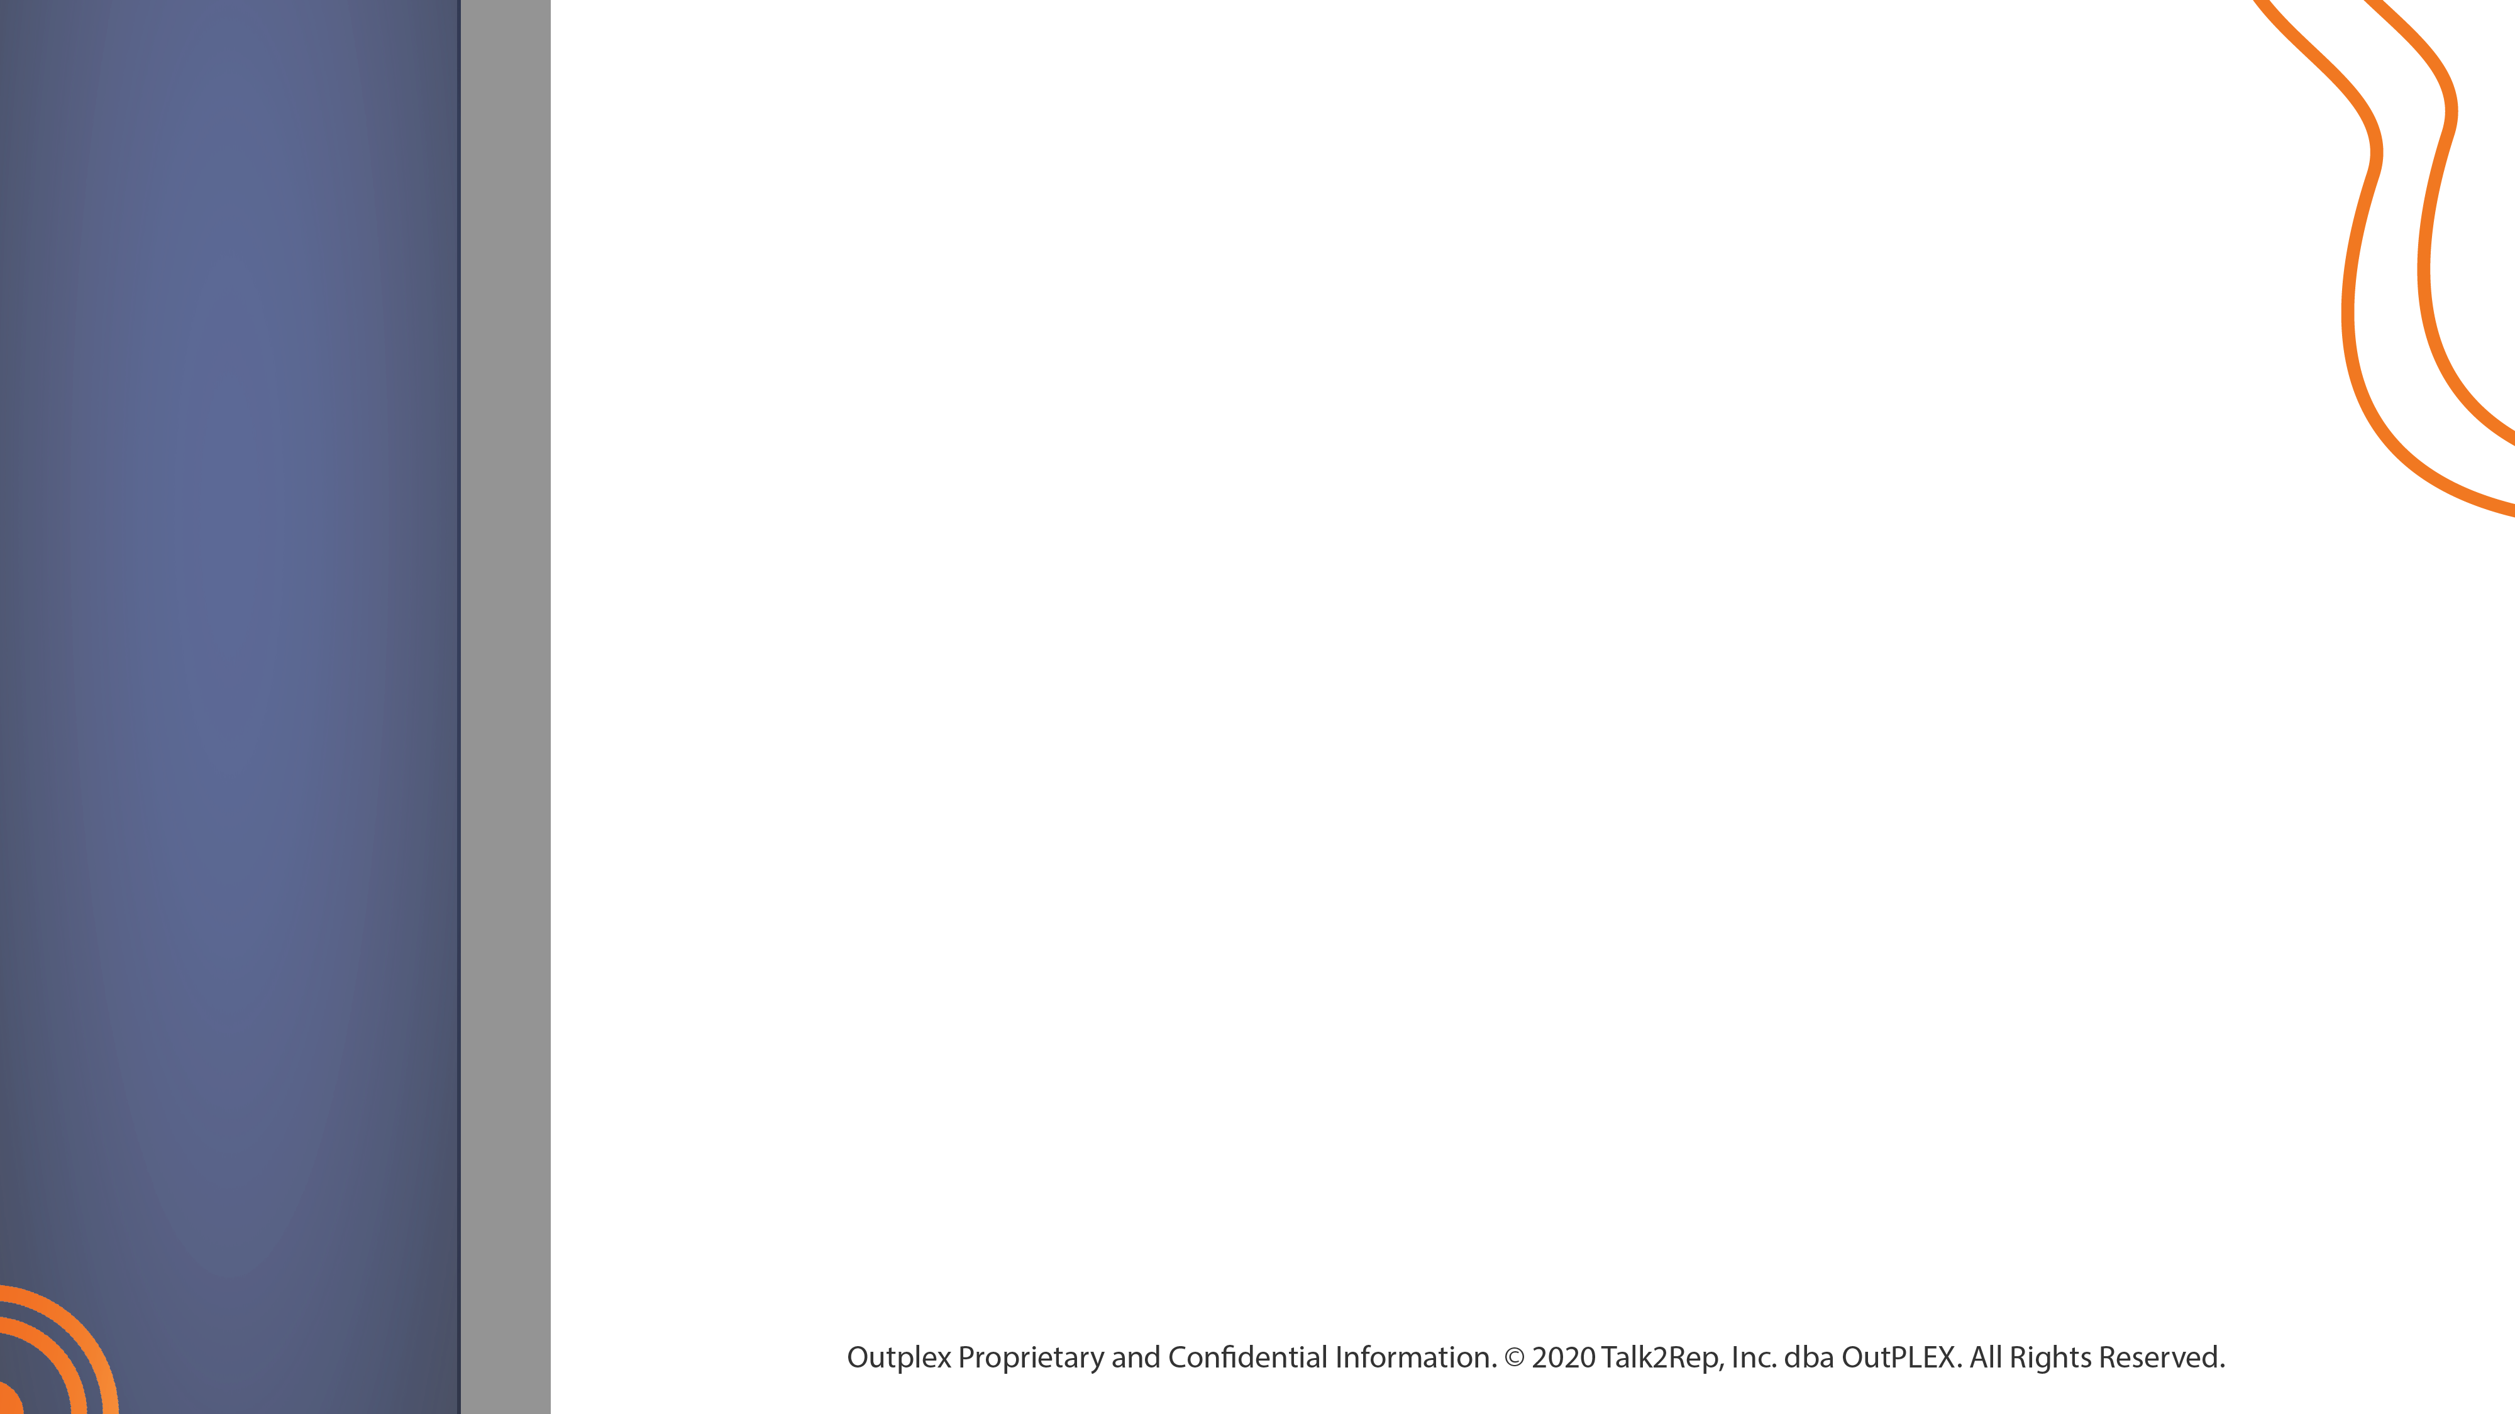


QA Evaluation Form

Slide 2
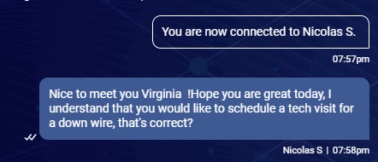
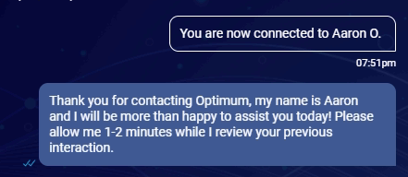

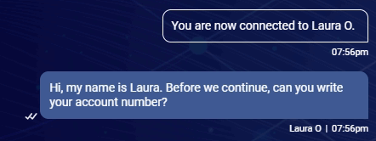
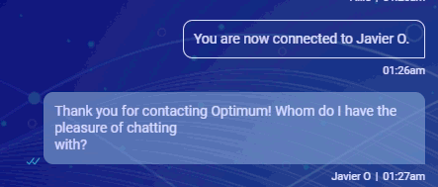

Welcome and Customer Engagement
1) Begin the conversation with the proper greeting and script. Use the customer's name throughout the interaction.

Slide 3
2) Display willingness to assist the customer.
Use a transitional statement to assure the customer you understand their needs and you will be happy to help.
I’ll be happy to assist you creating your Optimum ID!
I will be glad to answer all your questions about the bill.
I’ll be more than happy to change the WIFI password for you!

Slide 4
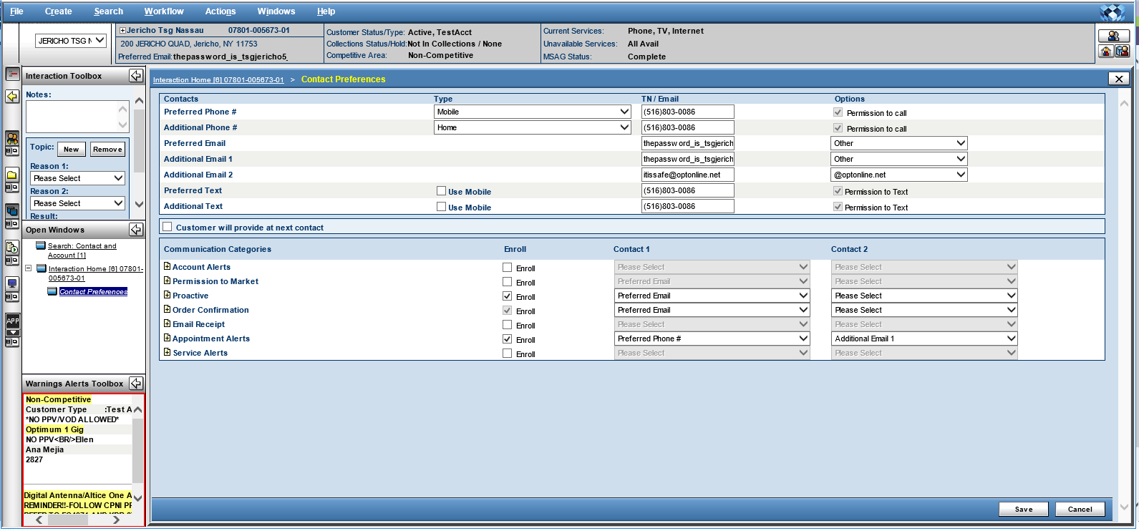
3) Update Contact Preference (CPC)
The agent must update the contact preference (CPC) when an account to avoid missed appointment in the future. “Include Phone number and Email Address”.

Slide 5
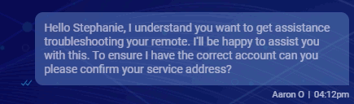

4) Protect the customer’s privacy and personal information by following the verification procedure.

Slide 6
Build a Connection
5) Utilize the appropriate holding time script and respond in the correct time frame.
Agent must keep the interaction active with the customer, not exceeding the time frame specified to respond of two minutes and sending appropriate holding and interactive scripts.
Response time: 2 minutes or less.
Thank you so much for your patience. I am still reviewing your bill.
Thank you for your time, I still running the tests.
Please stay with me, I am searching the information on your account.

Slide 7
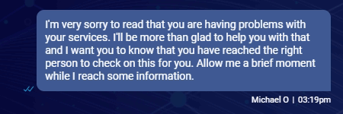
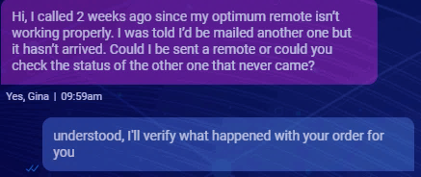


6) Convey a friendly demeanor throughout the interaction with empathy statements.
7) Proper use of punctuation, avoiding typographical errors and never using internal language with the customer.

Slide 8
Solution Building
8) Ask discovery and probing questions to provide a response or solutions to the customer’s inquiry.
Is this issue happening on all your devices?
When did you make the payment?
Is there any lights on the modem?
9) Use all available tools and resources to arrive at a personalized solution for the customer when applicable.
MT IBA ITT BOOST KDB Prime Home

Slide 9
10) Address all questions and concerns, provide the proper resolution and information.
Properly address all questions that the customer brings up and provide best possible solution. E.g:
- If the customer have a billing inquiry, wants to reset an ID password and is missing channels from the TV service, you need to bring a solution for all of them.
11) Provide assurance statements, promoting the value of the service.
Properly assurance statements promoting the value of the service in order to avoid the customer to disconnect the account. Eg:
- If the customer wants to disconnect the internet service, let him/her know about our over 2 million hotspots available over US with free WIFI.

Slide 10
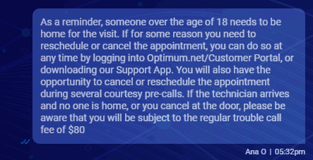
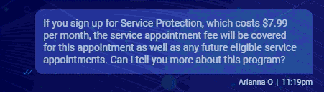
Altice Procedures
12) Inform about TC policies, appointment discipline, and recommendations of service protection.
Properly complete and throughout information and expectations in regard to the policies, procedures and recommendations, avoiding further misunderstanding with the customer.

Slide 11
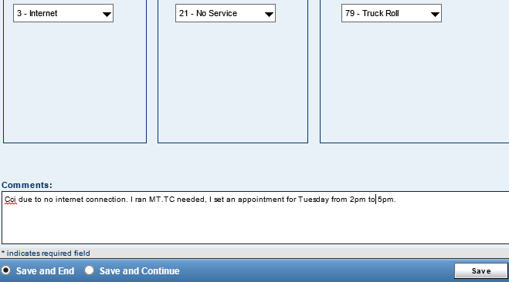
13) Leave thorough notations that document resolution and expectations set with the customer.
Thoroughly capture notes for the entire interaction and ensure all notes are easily understood, specifying the reason and resolution of the interaction. You should leave notes on Remedy and IDA.
14) Follow all applicable procedures with the customer.
Ensure all proper steps are strictly followed, including all troubleshooting steps and guidelines.

Slide 12
15) Educate the customer on all self-service options including mobile apps, IVR options, or web portals.
E.g:
- Please keep in mind that you can set security question on the website so you can reset the password.
- As a reminder, you can review your bills and make payments online through optimum.net
16) Use chat appropriate recap of the conversation and use proper closing script.
E.g:
- As a recap, you contacted us to add HBO on demand and create an Optimum ID. We added the channel and crate laura123. Thank you so much for contacting Optimum, it has been a pleasure to assist you today. If you have any further questions do not hesitate in contacting us back. Have a wonderful rest of your day!

Slide 13
Business critical
17) CPNI Breach and provide information from the customer’s account.
Disclose private information of the account as account holder’s name, address, phone or ID and make modifications as add channels, activate new modem, change WIFI password or create IDs without completing the security process.
Always ask for:
- CMAC of the modem
- ECM MAC or CA S/N of Altice One box
- Serial number or MAC of Cable box
- Access Code

Slide 14
18) Provided misleading information to the customer.
Incorrect information was provided to the customer, setting the wrong expectations.
E.g.
- You will receive a credit of $80 for the appointment fee.
- I will add a promotion on your account saving you $50.00
19) Arguing with the customer.
Disrespect the customer and answer in a rudely manner.
- I don’t care that your internet doesn’t work.
- You never pay on time, that’s not my problem.

Slide 15
20) No attempt to resolve.
Not following all proper steps with the customer and avoiding, providing the wrong resolution.
I’m not billing department please call to review your bill.
I can’t troubleshoot your modem. Contact us later.
21) Closing conversations on customers when not applicable.
Ending the interaction abruptly where the customer concern is not yet addressed or having an invalid transfer by sending the interaction back to the queue.

